Slide 1


Security Slide

Slide 2
1
Introduction
2
Types of Phishing
What is Phishing?
3
Protect Yourself from Phishing
4
What to do if you suspect Phishing

Slide 3
01
Introduction
What is Phishing?
PART ONE

Slide 4

What is Phishing
Phishing is a way cyber criminals trick you into giving them personal information. They send you fraudulent emails or text messages often pretending to be from large organisations you know or trust. They may try and steal your online banking logins, credit card details or passwords. Phishing can result in the loss of information, money or identity theft.

Slide 5
The message could be from a scammer, who might
say they’ve noticed some suspicious activity or log-in attempts — they haven’t
claim there’s a problem with your account or your payment information — there isn’t
say you need to confirm some personal or financial information — you don’t
include an invoice you don’t recognize — it’s fake
want you to click on a link to make a payment — but the link has malware
say you’re eligible to register for a government refund — it’s a scam
offer a coupon for free stuff — it’s not real

Slide 6
02
Types of Phishing
PART TWO

Slide 7






Types of
Phishing
Email Phishing
Scammers create emails that impersonate legitimate companies and attempt to steal your information.
Whaling
Scammers target high-ranking executives to gain access to sensitive data or money.
Spear Phishing
Similar to email phishing, but the messages are more personalized. For example, they may appear to come from your boss.
Pop up Phishing
Fraudulent pop-ups trick users into installing malware.
Clone Phishing
Scammers replicate an email you have received, but include a dangerous attachment or link.

Slide 8
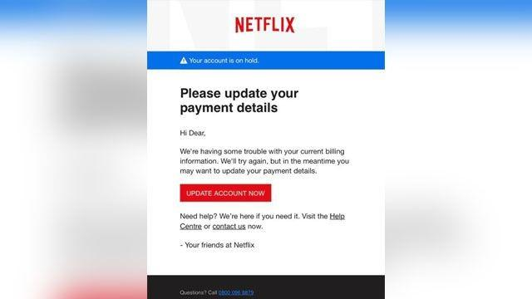
Sample Messege
At first glance, this email looks real, but it’s not. Scammers who send emails like this one are hoping you won’t notice it’s a fake.

Slide 9
Here are signs that this email is a scam, even though it looks like it comes from a company you know — and even uses the company’s logo in the header:
The email has a generic greeting.
The email says your account is on hold because of a billing problem.
The email invites you to click on a link to update your payment details.

Slide 10
While real companies might communicate with you by email, legitimate companies won’t email or text with a link to update your payment information. Phishing emails can often have real consequences for people who give scammers their information, including identity theft. And they might harm the reputation of the companies they’re spoofing.

Slide 11
03
Protect Yourself
PART THREE

Slide 12
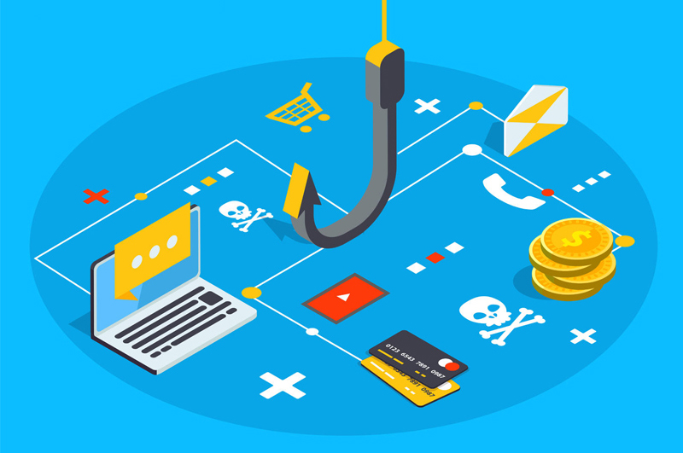
Four Ways To Protect Yourself
From Phishing
1. Protect your computer by using security software.
2. Protect your cell phone by setting software to update automatically.
3. Protect your accounts by using multi-factor authentication.
4. Protect your data by backing it up.

Slide 13
What to do if you suspect Phishing
04
PART FOUR

Slide 14
If you receive a suspicious email
Do not reply, even if you recognize the sender as a well-known business or financial institution. If you have an account with this institution, contact them directly and ask them to verify the information included in the email.
Do not click any links provided in these emails (or cut and paste them into a browser). This may download viruses to your computer, or at best, confirm your email address to phishers.
Do not open any attachments. If you receive an attachment you are not expecting, confirm with the senders that they did indeed send the message and meant to send an attachment.
Do not enter your personal information or passwords on an untrusted Web site or form referenced in this email.
Report any suspicious messages that claim to be from UMass Amherst or contain a suspicious attachment or link to itprotect@umass.edu.
Delete the message.

Slide 15
If you responded to a suspicious email
Contact your financial institution. Report the content of your email and your actions to the security or fraud department.
File a police report. Contact the Police Department at or your local police department.
If you have already provided your IT Account information in response to a phishing email, your account may be disabled (all accounts that display signs of suspicious activity will be frozen). It is critical that you:
Contact the IT Help Center to report the incident and get your IT Account re-instated (if applicable).
Change your IT Account password immediately in SPIRE. If your IT Account has been disabled, you will create a new password when you re-activate your account.
Change the passwords to all online accounts that may have been compromised.
Report the message to the Federal Trade Commission at spam@uce.gov or through their online form and to any organization impersonated in the email. You can also report the message to the Anti-Phishing Working Group at reportphishing@antiphishing.org, a group of Internet Service Providers, security vendors, financial institutions, and law enforcement agencies dedicated to fighting phishing.

Slide 16
Thanks for
listening

